Slide 1

myLunchBot
Millennials Disrupt Hackathon 2017

Slide 2

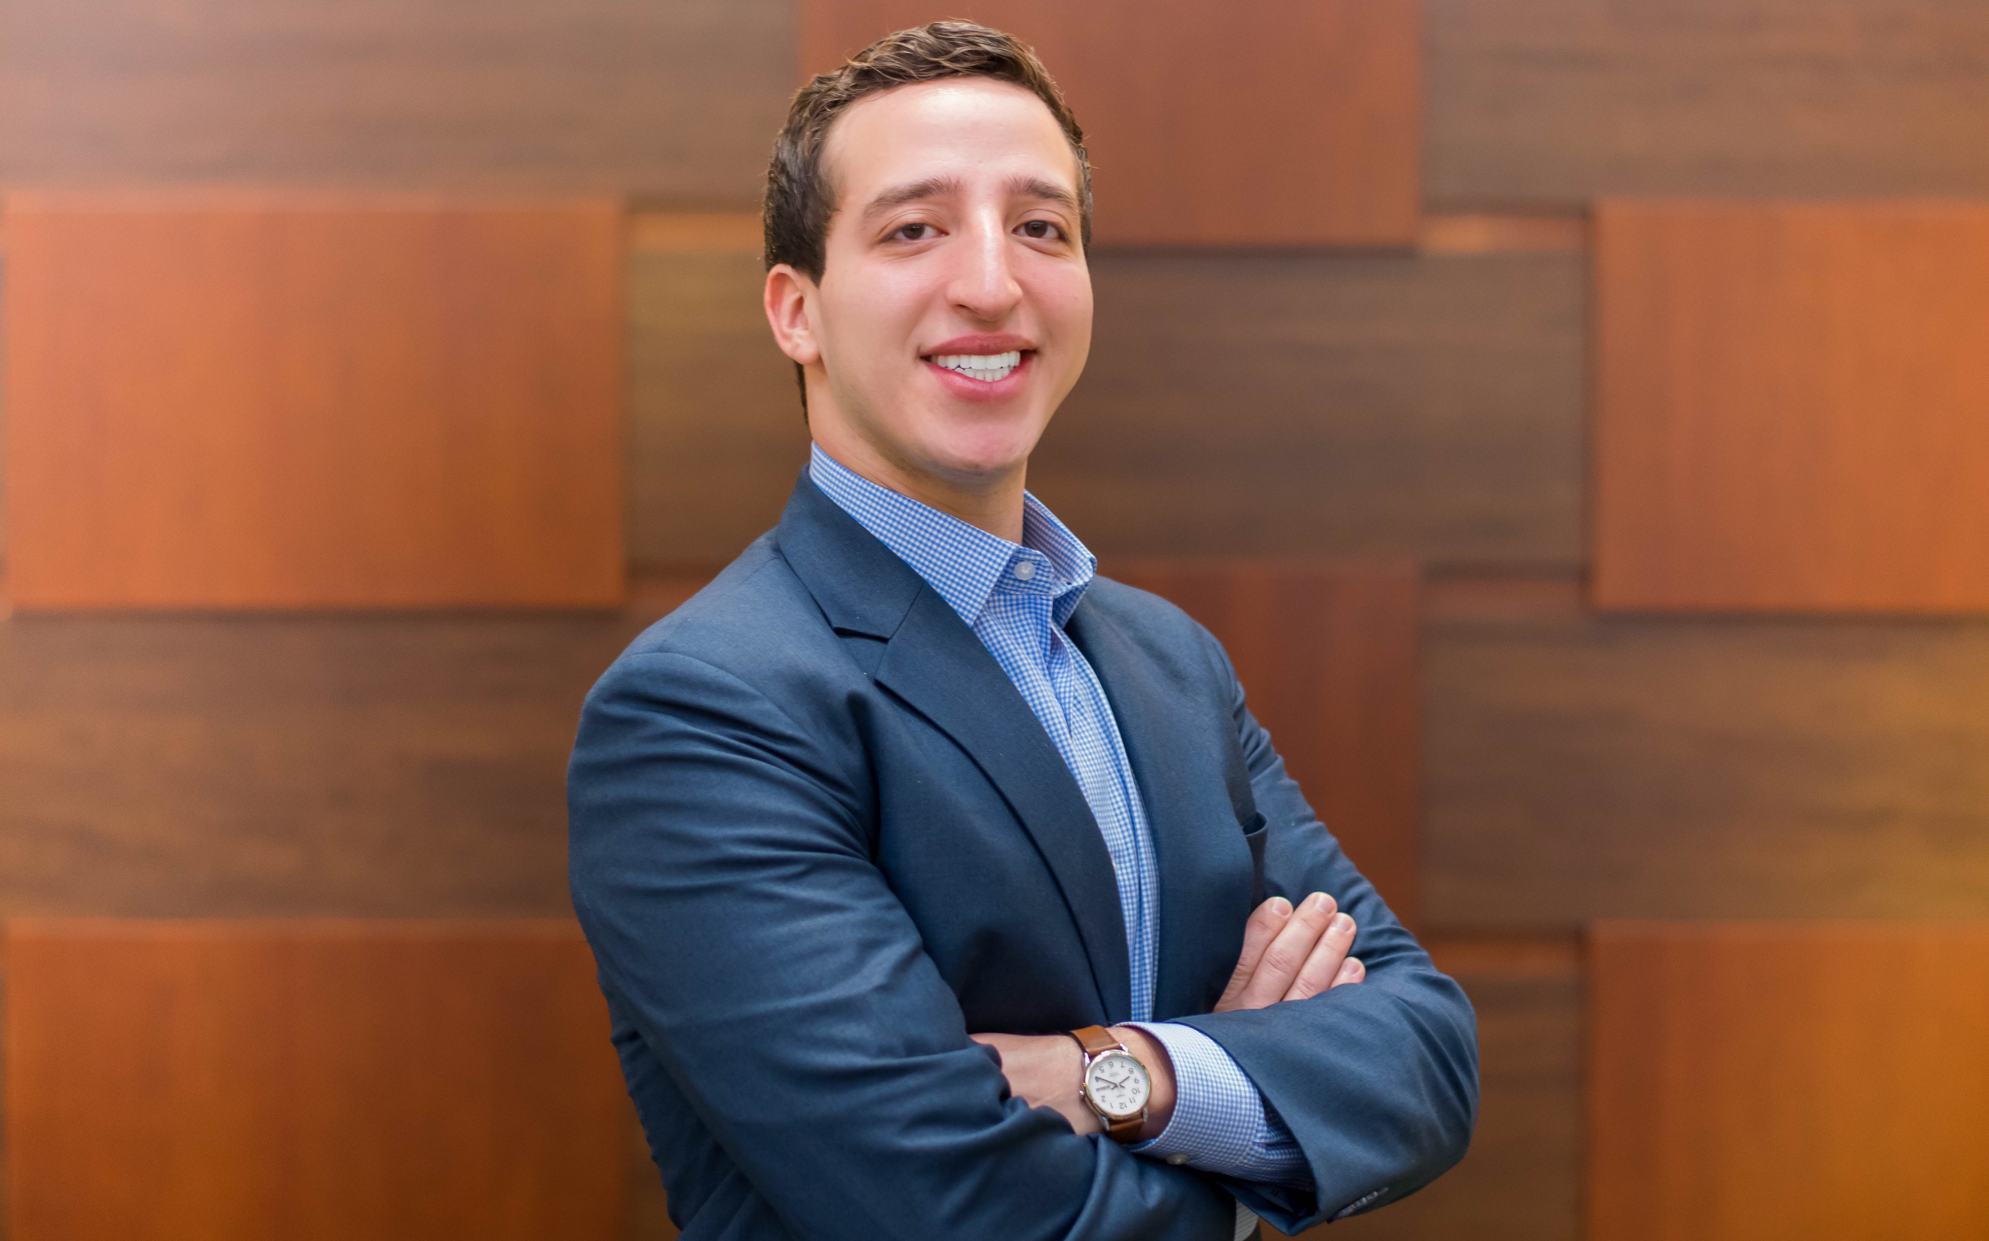

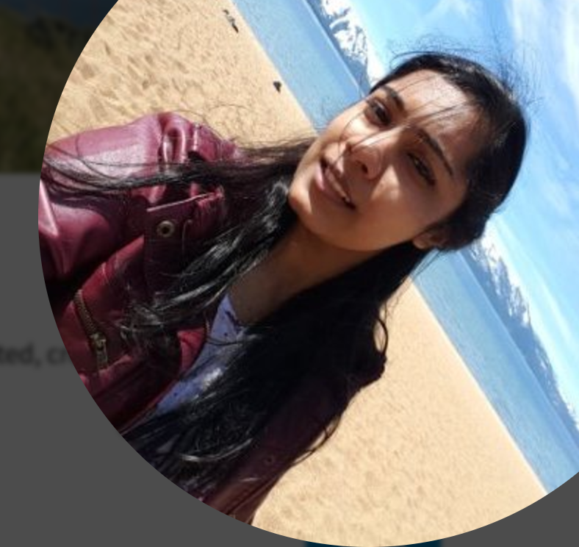


Millennials Disrupt Hackathon 2017
Prema Khatwani
Marketing Professional
Microsoft, Eros Group
MBA Graduate
(5+ Years in Dubai)
Joel Quinones
Developer
Capgemini,
(2.5+ Years in America)
Anoja Rajalakshmi
Firmware Engineer
Global Embedon,
MS in Comp. Eng
(3+ Years in India)
Prithvi Mallepula
Software Developer
Capgemini
MS in Comp. Sci
(1 Year in Chicago)
Notes:
Ladies and Gentlemen, I and my colleagues Shannon, Mark and Dominik are working together to solve this problem and make women turning 50 feel like “50 is the new 20”! And now, my colleague Shannon will talk about our business idea.
Reduce the size of Dominik’s picture

Slide 3
3%
of American’s live a healthy lifestyle
(The Atlantic)
66%
Loss of productivity due to unhealthy eating habits (huffingtonpost)
2-3x
more expensive than annual healthcare (huffingtonpost)
Notes:
https://www.theatlantic.com/health/archive/2016/03/less-than-3-percent-of-americans-live-a-healthy-lifestyle/475065/
http://www.huffingtonpost.com/2012/08/12/health-workplace-productivity-eating-nutrition-exercise_n_1752749.html
Less than 3% of American’s Live a healthy lifestyle (The Atlantic)
A new study that will be published in the journal Population Health Management shows that eating unhealthily is linked with a 66 percent increased risk of loss of productivity (Huffingtonpost).
“Total health-related employee productivity loss accounts for 77 percent of all such loss and costs employers two to three times more than annual healthcare expenses,” study researcher Ray Merrill, a health science professor at Brigham Young University, said in a statement (Huffingtonpost)

Slide 4
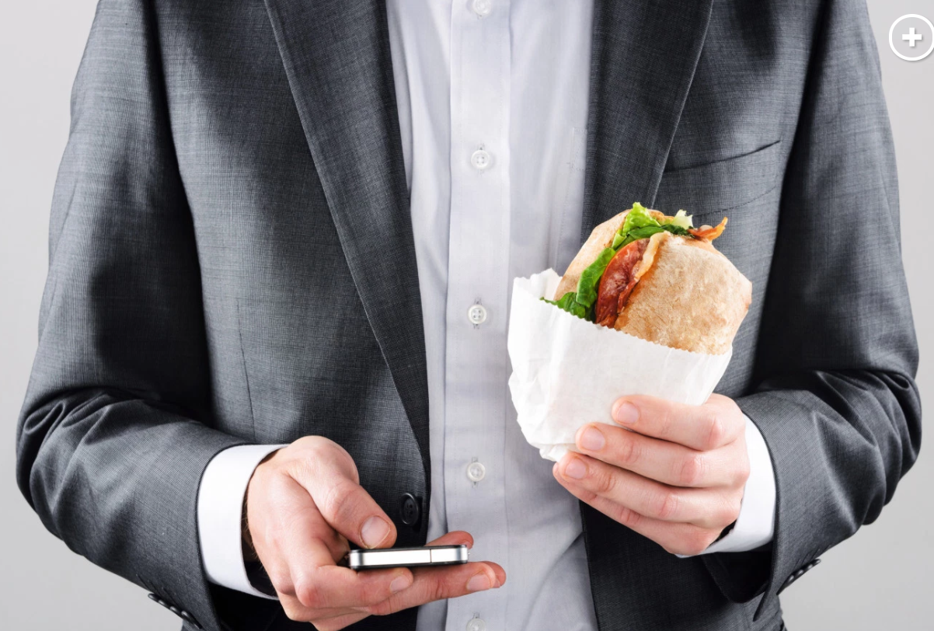
Why does this happen?
Research
50%
of working professionals in America take 30mins or less for lunch
29%
Skip lunch!
Notes:
https://www.pastemagazine.com/articles/2016/07/lunch-break.html
http://nypost.com/2014/02/02/millions-of-americans-skipping-lunch-to-work-study/

Slide 5
Results of Personal Interviews
Unpredictable work schedule
Lack of automation of all steps involved food ordering
Laborious food selection process
Notes:
We took a very user centric approach using design thinking. We interviewed users even before building/prototyping to find out what their current eating habits are like.

Slide 6



Solution
A web app (hosted on .tech)
Work with Cisco Spark, Amazon Alexa, Sales Force

Slide 7
PROFILE
Planned Order
SPARK
Restaurant/Food Repository
IMPORT SALESFORCE CALENDAR
Order Details
Alexa

Slide 8
Any Questions?

